Slide 1
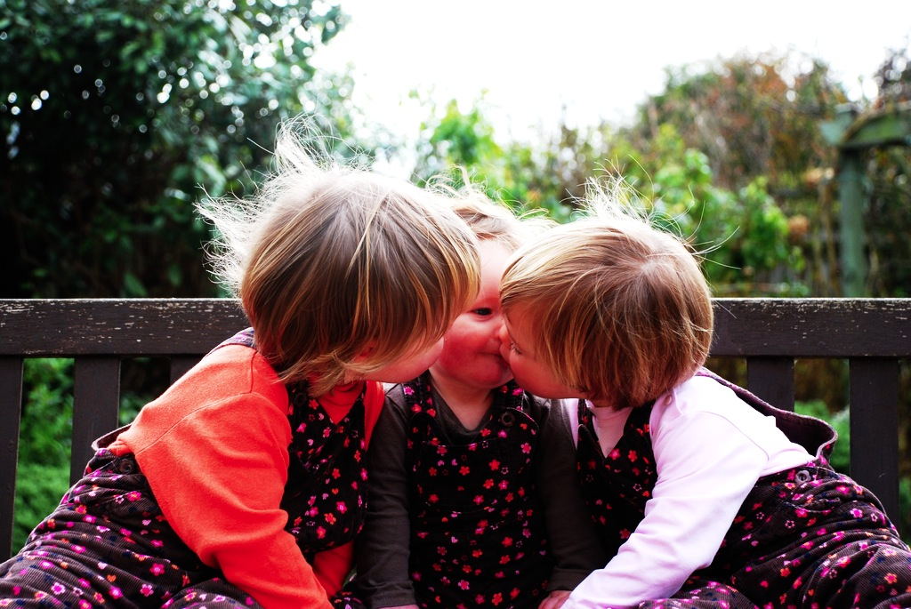

Joint Action
without Shared Intention

Slide 2
Joint action:
a goal-directed action, or something resembling one, comprising two or more agents’ goal-directed activities.

Slide 3


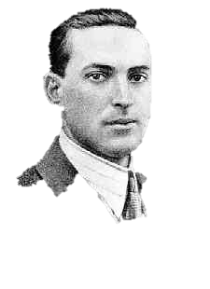


Joint action:
a goal-directed action, or something resembling one, comprising two or more agents’ goal-directed activities.
“the unique aspects of human cognition ... were driven by, or even constituted by, social co-operation”
(Moll & Tomasello 2007)
“perception, action, and cognition are grounded in social interaction”
(Sebanz & Knoblich 2008)

Slide 4

first
half

Slide 5
first
half
collective goals

Slide 6
What is the relation between a joint action and the goal (or goals) to which it is directed?

Slide 7

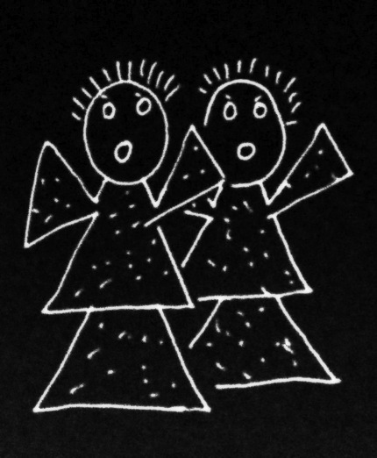
What is the relation between a joint action and the goal (or goals) to which it is directed?

Slide 8
What is the relation between a joint action and the goal (or goals) to which it is directed?

Slide 9
an individual
What is the relation between a joint action and the goal (or goals) to which it is directed?

Slide 10
an individual
What is the relation between a joint action and the goal (or goals) to which it is directed?
intention
activities
goal-state
goal-outcome
coordinates
specifies

Slide 11

‘I take a collective action to involve a collective [shared] intention.’

Slide 12
‘I take a collective action to involve a collective [shared] intention.’
‘Shared intentionality is the foundation upon which joint action is built.’
(Carpenter 2009, p. 381)

Slide 13
‘I take a collective action to involve a collective [shared] intention.’
‘Shared intentionality is the foundation upon which joint action is built.’
(Carpenter 2009, p. 381)
‘the key property of joint action lies in its internal component [...] in the participants’ having a “collective” or “shared” intention.’
(Alonso, 2009, pp. 444-5)

Slide 14
‘I take a collective action to involve a collective [shared] intention.’
‘Shared intentionality is the foundation upon which joint action is built.’
(Carpenter 2009, p. 381)
‘the key property of joint action lies in its internal component [...] in the participants’ having a “collective” or “shared” intention.’
(Alonso, 2009, pp. 444-5)
“it is precisely the meshing and sharing of psychological states ... that holds the key to understanding how humans have achieved their sophisticated and numerous forms of joint activity”
(Call 2009 p. 369)

Slide 15
‘I take a collective action to involve a collective [shared] intention.’
‘Shared intentionality is the foundation upon which joint action is built.’
(Carpenter 2009, p. 381)
‘the key property of joint action lies in its internal component [...] in the participants’ having a “collective” or “shared” intention.’
(Alonso, 2009, pp. 444-5)
“it is precisely the meshing and sharing of psychological states ... that holds the key to understanding how humans have achieved their sophisticated and numerous forms of joint activity”
(Call 2009 p. 369)

Slide 16
What is the relation between a joint action and the goal (or goals) to which it is directed?
shared intention
activities
goal-state
goal-outcome
coordinates
specifies

Slide 17
What is the relation between a joint action and the goal (or goals) to which it is directed?
- The goal of Ayesha and Beatrice’s action is to free the cat.
- It is not true that Ayesha and Beatrice have a shared intention. Nor any other kind of shared goal-state.
shared intention
behaviours
goal-state
goal-outcome
coordinates
specifies

Slide 18
What is the relation between a joint action and the goal (or goals) to which it is directed?
- The goal of Ayesha and Beatrice’s action is to free the cat.
- It is not true that Ayesha and Beatrice have a shared intention. Nor any other kind of shared goal-state.
shared intention
activities
goal-state
goal-outcome
coordinates
specifies

Slide 19
shared intention

Slide 20
awareness of joint-ness
at least one of the agents knows that they are not acting individually; she or they have ‘a conception of themselves as contributors to a collective end.’
awareness of others’ agency
at least one of the agents is aware of one or more of the others as an intentional agent.
awareness of others’ states or commitments
at least one of the agents who are F-ing is aware of, or has individuating beliefs about, some of the others’ intentions, beliefs or commitments concerning F.

Slide 21
awareness of joint-ness
at least one of the agents knows that they are not acting individually; she or they have ‘a conception of themselves as contributors to a collective end.’
awareness of others’ agency
at least one of the agents is aware of one or more of the others as an intentional agent.
awareness of others’ states or commitments
at least one of the agents who are F-ing is aware of, or has individuating beliefs about, some of the others’ intentions, beliefs or commitments concerning F.

Slide 22
awareness of joint-ness
at least one of the agents knows that they are not acting individually; she or they have ‘a conception of themselves as contributors to a collective end.’
awareness of others’ agency
at least one of the agents is aware of one or more of the others as an intentional agent.
awareness of others’ states or commitments
at least one of the agents who are F-ing is aware of, or has individuating beliefs about, some of the others’ intentions, beliefs or commitments concerning F.

Slide 23
awareness of joint-ness
at least one of the agents knows that they are not acting individually; she or they have ‘a conception of themselves as contributors to a collective end.’
awareness of others’ agency
at least one of the agents is aware of one or more of the others as an intentional agent.
awareness of others’ states or commitments
at least one of the agents who are F-ing is aware of, or has individuating beliefs about, some of the others’ intentions, beliefs or commitments concerning F.

Slide 24
awareness of joint-ness
at least one of the agents knows that they are not acting individually; she or they have ‘a conception of themselves as contributors to a collective end.’
awareness of others’ agency
at least one of the agents is aware of one or more of the others as an intentional agent.
awareness of others’ states or commitments
at least one of the agents who are F-ing is aware of, or has individuating beliefs about, some of the others’ intentions, beliefs or commitments concerning F.

Slide 25
joint action without shared intention

Slide 26
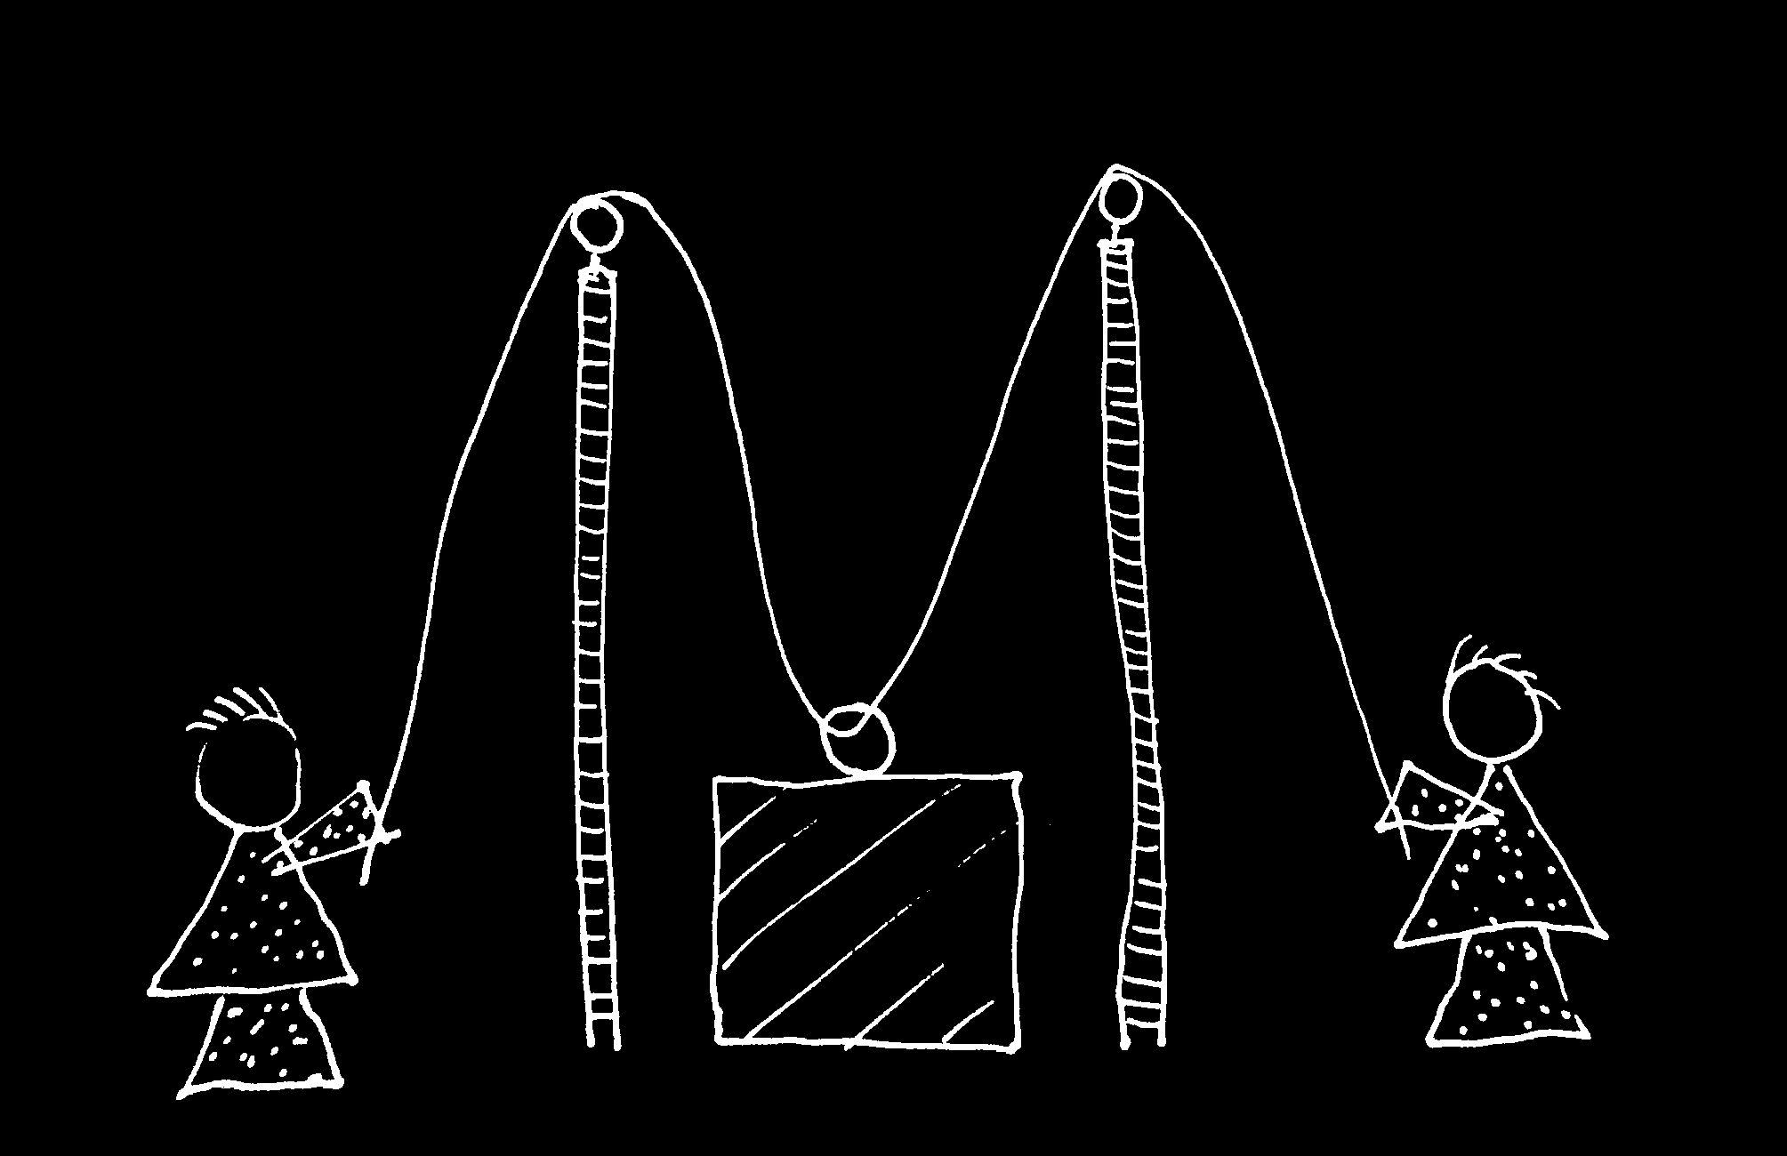
cf. Vesper et al, Neutal Networks (2010)

Slide 27


Slide 28
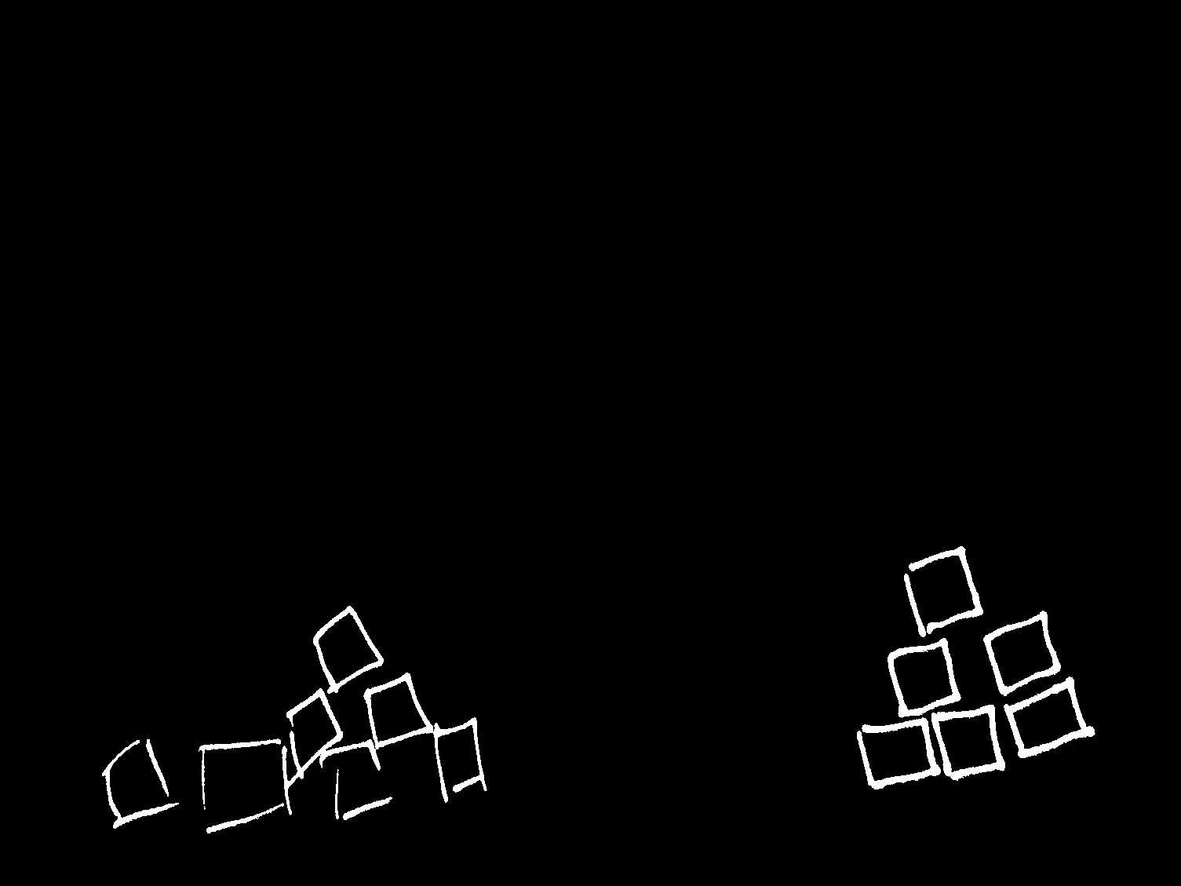


Slide 30
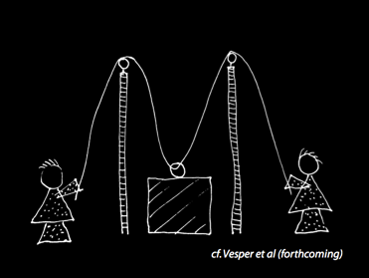

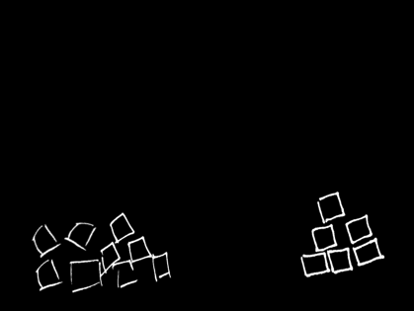

Slide 31
How can we characterise the relation between joint actions and their goal-outcomes without invoking shared intentions?

Slide 32
How can we characterise the relation between joint actions and their goal-outcomes without invoking shared intentions?
There is a single goal-outcome such that each agent’s activities are directed to it (a distributive goal).
The agents’ activities are coordinated.
The goal-outcome would normally occur partly as a consequence of this coordination, or would normally be partly constituted by it

Slide 33
How can we characterise the relation between joint actions and their goal-outcomes without invoking shared intentions?
There is a single goal-outcome such that each agent’s activities are directed to it (a distributive goal).
The agents’ activities are coordinated.
The goal-outcome would normally occur partly as a consequence of this coordination, or would normally be partly constituted by it
collective goal

Slide 34
How can we characterise the relation between joint actions and their goal-outcomes without invoking shared intentions?
There is a single goal-outcome such that each agent’s activities are directed to it (a distributive goal).
The agents’ activities are coordinated.
The goal-outcome would normally occur partly as a consequence of this coordination, or would normally be partly constituted by it
collective goal

Slide 35
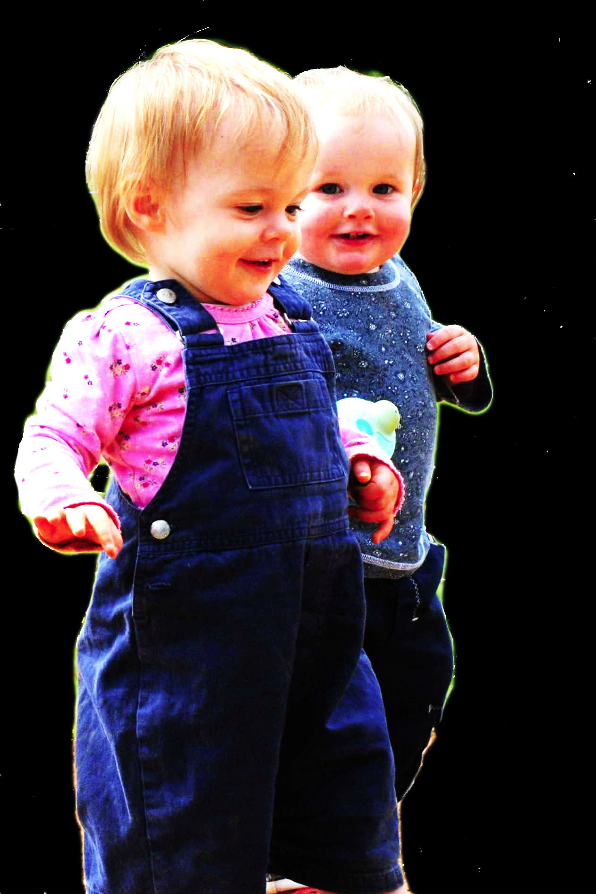
second
half
Notes:
This is an overview of the project and its aims

Slide 36
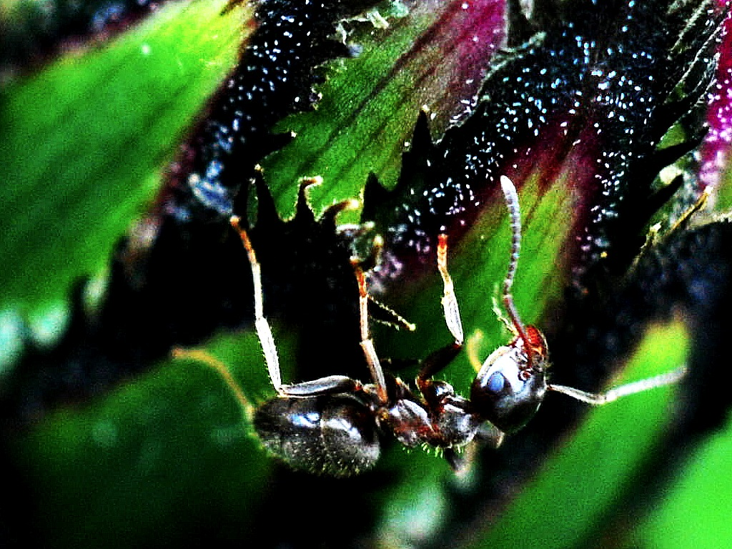
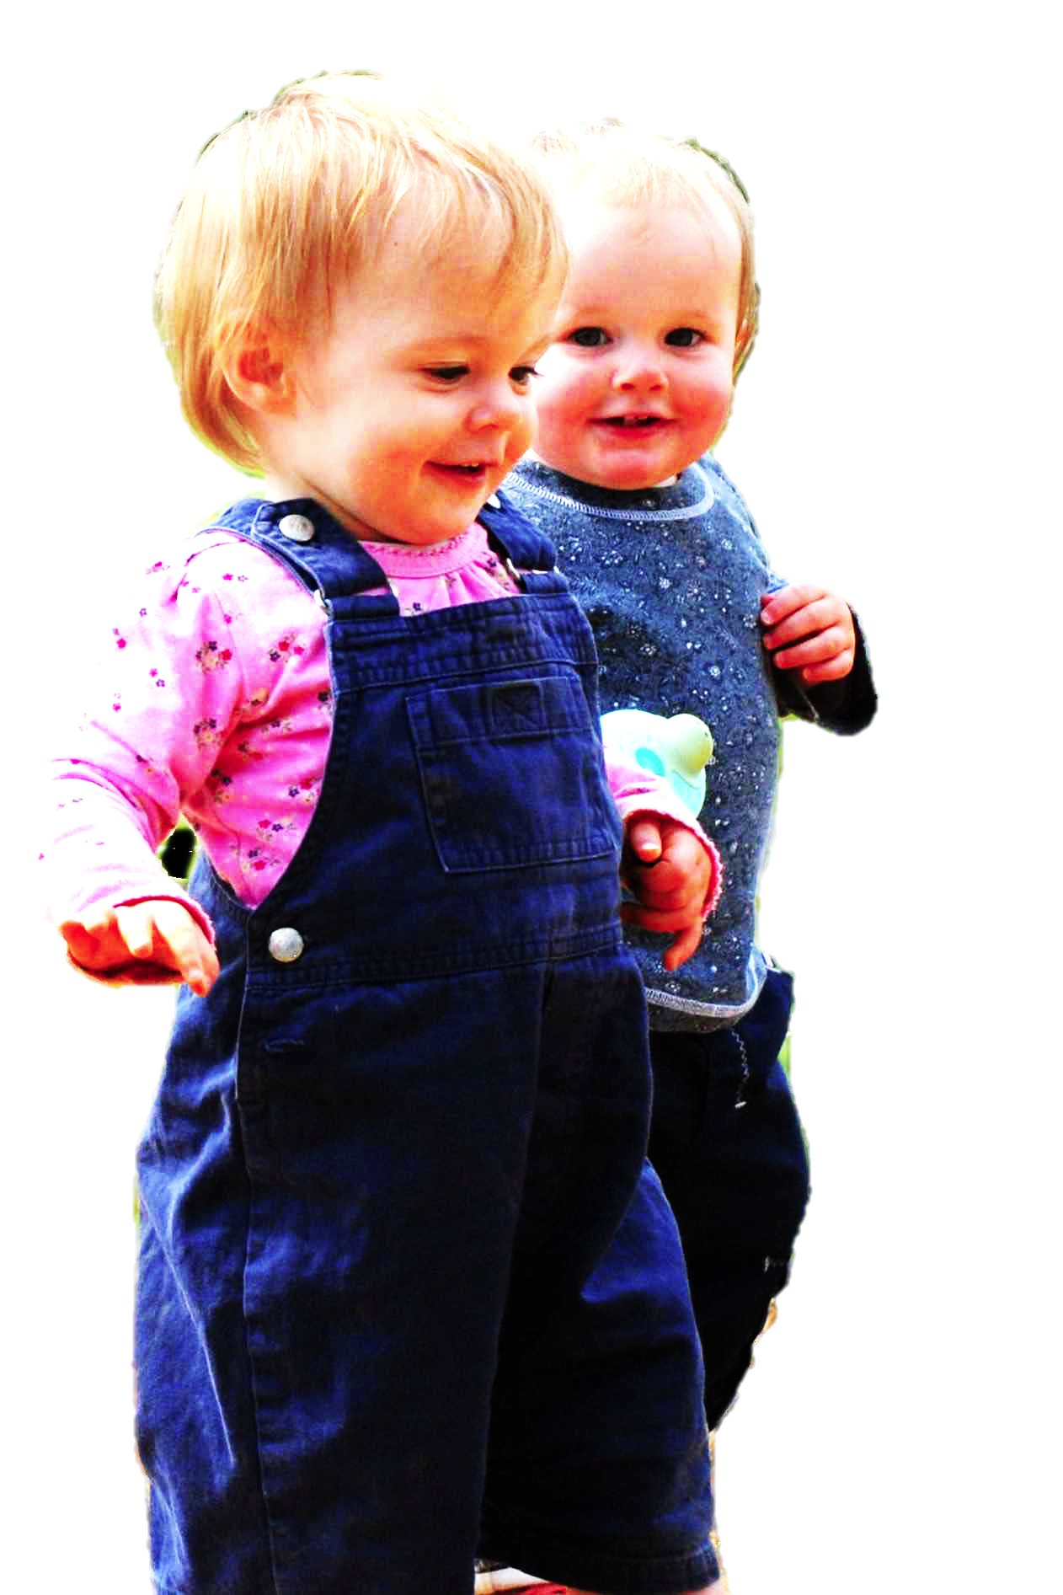

Slide 37
tidying up the toys together
(Behne et al 2005)
cooperatively pulling handles in sequence to make a dog-puppet sing
(Brownell et al 2006)
bouncing a ball on a large trampoline together
(Tomasello & Carpenter 2007)
pretending to row a boat together

Slide 38
Joint actions in children’s second year involve ...
- abilities to switch roles
- sensitivity to others’ mental states
Buttelmann, Carpenter et al (2009)
- dispositions to help partners
Warneken, Chen et al (2009)
- partner-specific projects
Liebal, Behne et al (2009)
...
tidying up the toys together
(Behne et al 2005)
cooperatively pulling handles in sequence to make a dog-puppet sing
(Brownell et al 2006)
bouncing a ball on a large trampoline together
(Tomasello & Carpenter 2007)
pretending to row a boat together

Slide 39
There is a single goal-outcome such that each agent’s activities are directed to it (a distributive goal).
The agents’ activities are coordinated.
The goal-outcome would normally occur partly as a consequence of this coordination, or would normally be partly constituted by it.
collective goal

Slide 40
There is a single goal-outcome such that each agent’s activities are directed to it (a distributive goal).
The agents’ activities are coordinated.
The goal-outcome would normally occur partly as a consequence of this coordination, or would normally be partly constituted by it.
collective goal

Slide 41
There is a single goal-outcome such that each agent’s activities are directed to it (a distributive goal).
The agents’ activities are coordinated.
The goal-outcome would normally occur partly as a consequence of this coordination, or would normally be partly constituted by it.
Each agent expects each of the other agents to perform activities directed to the goal.
Each agent expects the goal to occur as a common effect of all their goal-directed actions.
collective goal

Slide 42
There is a single goal-outcome such that each agent’s activities are directed to it (a distributive goal).
The agents’ activities are coordinated.
The goal-outcome would normally occur partly as a consequence of this coordination, or would normally be partly constituted by it.
Each agent expects each of the other agents to perform activities directed to the goal.
Each agent expects the goal to occur as a common effect of all their goal-directed actions.
collective goal
shared goal

Slide 43
What is the relation between a joint action and the goal (or goals) to which it is directed?
shared intention or shared goal
=
activities
goal-state
goal-outcome
coordinates
specifies

Slide 44
There is a single goal-outcome such that each agent’s activities are directed to it (a distributive goal).
The agents’ activities are coordinated.
The goal-outcome would normally occur partly as a consequence of this coordination, or would normally be partly constituted by it.
Each agent expects each of the other agents to perform activities directed to the goal.
Each agent expects the goal to occur as a common effect of all their goal-directed actions.
collective goal
shared goal

Slide 45
There is a single goal-outcome such that each agent’s activities are directed to it (a distributive goal).
The agents’ activities are coordinated.
The goal-outcome would normally occur partly as a consequence of this coordination, or would normally be partly constituted by it.
Each agent expects each of the other agents to perform activities directed to the goal.
Each agent expects the goal to occur as a common effect of all their goal-directed actions.
collective goal
shared goal

Slide 46
Intentions are …
* attitudes to propositions
* conclusions of practical reasoning
* elements of plans
* defined by norms of consistency
Each agent expects each of the other agents to perform activities directed to the goal.
Each agent expects the goal to occur as a common effect of all their goal-directed actions.

Slide 47
There is a single goal-outcome such that each agent’s activities are directed to it (a distributive goal).
The agents’ activities are coordinated.
The goal-outcome would normally occur partly as a consequence of this coordination, or would normally be partly constituted by it.
Each agent expects each of the other agents to perform activities directed to the goal.
Each agent expects the goal to occur as a common effect of all their goal-directed actions.
collective goal
shared goal

Slide 48
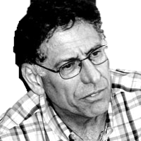

Slide 49
What is shared intention?
Functional characterisation
Substantial account

Slide 50
What is shared intention?
Functional characterisation
shared intention serves to (a) coordinate activities, (b) coordinate planning and (c) structure bargaining
Substantial account

Slide 51
What is shared intention?
Functional characterisation
shared intention serves to (a) coordinate activities, (b) coordinate planning and (c) structure bargaining
Substantial account
We have a shared intention that we J =
“1. (a) I intend that we J and (b) you intend that we J
“2. I intend that we J in accordance with and because of la, lb, and meshing subplans of la and lb; you intend [likewise] …
“3. 1 and 2 are common knowledge between us”
(Bratman 1993: View 4)

Slide 52
What is shared intention?
Functional characterisation
shared intention serves to (a) coordinate activities, (b) coordinate planning and (c) structure bargaining
Substantial account
We have a shared intention that we J =
“1. (a) I intend that we J and (b) you intend that we J
“2. I intend that we J in accordance with and because of la, lb, and meshing subplans of la and lb; you intend [likewise] …
“3. 1 and 2 are common knowledge between us”
(Bratman 1993: View 4)
{
Intentions about intentions

Slide 53
What is shared intention?
Functional characterisation
shared intention serves to (a) coordinate activities, (b) coordinate planning and (c) structure bargaining
Substantial account
We have a shared intention that we J =
“1. (a) I intend that we J and (b) you intend that we J
“2. I intend that we J in accordance with and because of la, lb, and meshing subplans of la and lb; you intend [likewise] …
“3. 1 and 2 are common knowledge between us”
(Bratman 1993: View 4)
{
Intentions about intentions
{
Knowledge of others’ knowledge of intentions about intentions

Slide 54
“philosophers ... postulate complex intentional structures that often seem to be beyond human cognitive ability in real-time social interactions.”
(Knoblich & Sebanz 2008: 2022)
What is shared intention?
Functional characterisation
shared intention serves to (a) coordinate activities, (b) coordinate planning and (c) structure bargaining
Substantial account
We have a shared intention that we J =
“1. (a) I intend that we J and (b) you intend that we J
“2. I intend that we J in accordance with and because of la, lb, and meshing subplans of la and lb; you intend [likewise] …
“3. 1 and 2 are common knowledge between us”
(Bratman 1993: View 4)
{
Intentions about intentions
{
Knowledge of others’ knowledge of intentions about intentions

Slide 55
“philosophers ... postulate complex intentional structures that often seem to be beyond human cognitive ability in real-time social interactions.”
Functional characterisation
shared intention serves to (a) coordinate activities, (b) coordinate planning and (c) structure bargaining
Substantial account
We have a shared intention that we J =
“1. (a) I intend that we J and (b) you intend that we J
“2. I intend that we J in accordance with and because of la, lb, and meshing subplans of la and lb; you intend [likewise] …
“3. 1 and 2 are common knowledge between us”
(Bratman 1993: View 4)
{
Intentions about intentions
{
Knowledge of others’ knowledge of intentions about intentions

Slide 56
“philosophers ... postulate complex intentional structures that often seem to be beyond human cognitive ability in real-time social interactions.”
Functional characterisation
shared intention serves to (a) coordinate activities, (b) coordinate planning and (c) structure bargaining
Substantial account
We have a shared intention that we J =
“1. (a) I intend that we J and (b) you intend that we J
“2. I intend that we J in accordance with and because of la, lb, and meshing subplans of la and lb; you intend [likewise] …
“3. 1 and 2 are common knowledge between us”
(Bratman 1993: View 4)
{
Intentions about intentions
{
Knowledge of others’ knowledge of intentions about intentions

Slide 57
“philosophers ... postulate complex intentional structures that often seem to be beyond human cognitive ability in real-time social interactions.”
“philosophers ... postulate complex intentional structures that often seem to be beyond human cognitive ability in real-time social interactions.”
(Knoblich & Sebanz 2008: 2022)
Functional characterisation
shared intention serves to (a) coordinate activities, (b) coordinate planning and (c) structure bargaining
Substantial account
We have a shared intention that we J =
“1. (a) I intend that we J and (b) you intend that we J
“2. I intend that we J in accordance with and because of la, lb, and meshing subplans of la and lb; you intend [likewise] …
“3. 1 and 2 are common knowledge between us”
(Bratman 1993: View 4)
{
Intentions about intentions
{
Knowledge of others’ knowledge of intentions about intentions

Slide 58
tidying up the toys together
(Behne et al 2005)
cooperatively pulling handles in sequence to make a dog-puppet sing
(Brownell et al 2006)
bouncing a ball on a large trampoline together
(Tomasello & Carpenter 2007)
pretending to row a boat together

Slide 59


Slide 60
“the unique aspects of human cognition ... were driven by, or even constituted by, social co-operation”
(Moll & Tomasello 2007)
“perception, action, and cognition are grounded in social interaction”
(Sebanz & Knoblich 2008)

Slide 61
collective goal
shared goal
...
shared intention
“the unique aspects of human cognition ... were driven by, or even constituted by, social co-operation”
(Moll & Tomasello 2007)
“perception, action, and cognition are grounded in social interaction”
(Sebanz & Knoblich 2008)

Slide 62
collective goal
shared goal
...
shared intention

Slide 63
application
Notes:
This is an overview of the project and its aims

Slide 64
“regular participation in cooperative, cultural interactions during ontogeny leads children to construct uniquely powerful forms of cognitive representation.”
(Moll & Tomasello 2006: 2-3)

Slide 65
“regular participation in cooperative, cultural interactions during ontogeny leads children to construct uniquely powerful forms of cognitive representation.”
(Moll & Tomasello 2006: 2-3)
how does that work?

Slide 66
“regular participation in cooperative, cultural interactions during ontogeny leads children to construct uniquely powerful forms of cognitive representation.”
(Moll & Tomasello 2006: 2-3)
how does that work?
“we use here a modified version of Bratman’s (1992) definition of ‘shared cooperative activities’.”
(ibid.)

Slide 67
“regular participation in cooperative, cultural interactions during ontogeny leads children to construct uniquely powerful forms of cognitive representation.”
(Moll & Tomasello 2006: 2-3)
how does that work?
“we use here a modified version of Bratman’s (1992) definition of ‘shared cooperative activities’.”
(ibid.)
not like this!

Slide 68
“regular participation in cooperative, cultural interactions during ontogeny leads children to construct uniquely powerful forms of cognitive representation.”
(Moll & Tomasello 2006: 2-3)
how does that work?

Slide 69
The problem of opaque means

Slide 70
your-goal-is-my-goal

Slide 71
your-goal-is-my-goal
1. We are about to engage in some joint action* or other
2. I am not about to change my goal.
Therefore:
3. Your actions also will be directed to this goal.
[*in the minimal sense associated with distributive goals]

Slide 72
understanding goals
capacity to share goals
understanding communicative intent

Slide 73


failed reach
point
source: Hare & Tomasello (2004)

Slide 74
failed reach
point
source: Hare & Tomasello (2004)
“to understand pointing, the subject needs to understand more than the individual goal-directed behaviour. She needs to understand that ... the other attempts to communicate to her ... and ... the communicative intention behind the gesture”
(Moll & Tomsello 2007)

Slide 75

failed reach
point
source: Hare & Tomasello (2004)
source: Leekam et al (2010)

Slide 76
“the adult’s social cues conveyed her communicative intent, which in turn encouraged the child to ‘see through the sign’. “
(Leekam, Solomon & Teoh 2010:118)
source: Leekam et al (2010)

Slide 77
understanding goals
capacity to share goals
understanding communicative intent

Slide 79
‘Ayesha and Beatrice between them lifted the table’

Slide 80
‘Ayesha and Beatrice between them lifted the table’
‘Left Leg and Right Leg between them supported the table’
‘Ayesha and Beatrice between them lifted the table intentionally’

Slide 81
‘Ayesha and Beatrice between them lifted the table’
‘Left Leg and Right Leg between them supported the table’
‘Ayesha and Beatrice between them lifted the table intentionally’

Slide 84
Contrast with Csibra
Teleological and referential action interpretation “rely on different kinds of action understanding”
...
they are initially two distinct “action interpretation systems”
(Csibra, 2003: 546)
“referential expectation may also originate from conceiving gaze shifts as communicative acts”
(Csibra, 2003)

Slide 86
There is a single goal-outcome such that each agent’s activities are directed to it (a distributive goal).
The agents’ activities are coordinated.
The goal-outcome would normally occur partly as a consequence of this coordination, or would normally be partly constituted by it.
Each agent expects each of the other agents to perform activities directed to the goal.
Each agent expects the goal to occur as a common effect of all their goal-directed actions.
collective goal
shared goal

Slide 87

“the unique aspects of human cognition ... were driven by, or even constituted by, social co-operation”
(Moll & Tomasello 2007)

Slide 88
“the unique aspects of human cognition ... were driven by, or even constituted by, social co-operation”
(Moll & Tomasello 2007)
“perception, action, and cognition are grounded in social interaction … hallmarks of individual cognition originated through the need to interact with others”

Slide 89
“the unique aspects of human cognition ... were driven by, or even constituted by, social co-operation”
(Moll & Tomasello 2007)
“perception, action, and cognition are grounded in social interaction … hallmarks of individual cognition originated through the need to interact with others”

Slide 90
Human social cognition, including full-blown theory of mind cognition, is built on capacities for joint action and their exercise.
“the unique aspects of human cognition ... were driven by, or even constituted by, social co-operation”
(Moll & Tomasello 2007)
“perception, action, and cognition are grounded in social interaction … hallmarks of individual cognition originated through the need to interact with others”

Slide 91

Human social cognition, including full-blown theory of mind cognition, is built on capacities for joint action and their exercise.
“the unique aspects of human cognition ... were driven by, or even constituted by, social co-operation”
(Moll & Tomasello 2007)
“perception, action, and cognition are grounded in social interaction … hallmarks of individual cognition originated through the need to interact with others”

Slide 92
Human social cognition, including full-blown theory of mind cognition, is built on capacities for joint action and their exercise.
Objections
1. Full-blown theory of mind cognition comes before joint action
2. Joint action presupposes full-blown theory of mind cognition

Slide 93
Human social cognition, including full-blown theory of mind cognition, is built on capacities for joint action and their exercise.
Objections
1. Full-blown theory of mind cognition comes before joint action
2. Joint action presupposes full-blown theory of mind cognition

Slide 94
Human social cognition, including full-blown theory of mind cognition, is built on capacities for joint action and their exercise.

Slide 95
third
half part
Notes:
This is an overview of the project and its aims

Slide 96
Functional characterisation
shared intention serves to (a) coordinate activities, (b) coordinate planning and (c) structure bargaining
Substantial account
We have a shared intention that we J =
“1. (a) I intend that we J and (b) you intend that we J
“2. I intend that we J in accordance with and because of la, lb, and meshing subplans of la and lb; you intend [likewise] …
“3. 1 and 2 are common knowledge between us”
(Bratman 1993: View 4)
{
Intentions about intentions
{
Knowledge of others’ knowledge of intentions about intentions

Slide 97
Functional characterisation
shared intention serves to (a) coordinate activities, (b) coordinate planning and (c) structure bargaining
Substantial account
We have a shared intention that we J =
“1. (a) I intend that we J and (b) you intend that we J
“2. I intend that we J in accordance with and because of la, lb, and meshing subplans of la and lb; you intend [likewise] …
“3. 1 and 2 are common knowledge between us”
(Bratman 1993: View 4)
“regular participation in cooperative, cultural interactions during ontogeny leads children to construct uniquely powerful forms of cognitive representation.”
(Moll & Tomasello 2006: 2-3)
{
Intentions about intentions
{
Knowledge of others’ knowledge of intentions about intentions

Slide 98
Functional characterisation
shared intention serves to (a) coordinate activities, (b) coordinate planning and (c) structure bargaining
Substantial account
We have a shared intention that we J =
“1. (a) I intend that we J and (b) you intend that we J
“2. I intend that we J in accordance with and because of la, lb, and meshing subplans of la and lb; you intend [likewise] …
“3. 1 and 2 are common knowledge between us”
(Bratman 1993: View 4)
“regular participation in cooperative, cultural interactions during ontogeny leads children to construct uniquely powerful forms of cognitive representation.”
(Moll & Tomasello 2006: 2-3)
“we use here a modified version of Bratman’s (1992) definition of ‘shared cooperative activities’.”
(ibid.)
Intentions about intentions
{
Knowledge of others’ knowledge of intentions about intentions

Slide 99
Functional characterisation
shared intention serves to (a) coordinate activities, (b) coordinate planning and (c) structure bargaining
Substantial account
We have a shared intention that we J =
“1. (a) I intend that we J and (b) you intend that we J
“2. I intend that we J in accordance with and because of la, lb, and meshing subplans of la and lb; you intend [likewise] …
“3. 1 and 2 are common knowledge between us”
(Bratman 1993: View 4)
{
Intentions about intentions
{
Knowledge of others’ knowledge of intentions about intentions

Slide 101
block
rises
Many agents, one outcome there is a single outcome to which each agent’s activities are individually directed.

Slide 102
block
rises
distributive goal
Many agents, one outcome there is a single outcome to which each agent’s activities are individually directed.

Slide 104

Joint actions in children’s second year involve ...
- abilities to switch roles
- sensitivity to others’ mental states
Buttelmann, Carpenter et al (2009)
- dispositions to help partners
Warneken, Chen et al (2009)
- partner-specific projects
Liebal, Behne et al (2009)
...
tidying up the toys together
(Behne et al 2005)
cooperatively pulling handles in sequence to make a dog-puppet sing
(Brownell et al 2006)
bouncing a ball on a large trampoline together
(Tomasello & Carpenter 2007)
pretending to row a boat together

Slide 105
joint action

Slide 106
The agents’ activities have a single goal.*
This isn’t just a matter of each individual agent’s activities having that goal.
[*could be weakened]

Slide 107
The agents’ activities have a single goal.*
This isn’t just a matter of each individual agent’s activities having that goal.
[*could be weakened]
parcel caught
Many agents, one outcome there is a single outcome to which each agent’s activities are individually directed.

Slide 109
‘Ayesha and Beatrice between them lifted the table’

Slide 110
‘Ayesha and Beatrice between them lifted the table’
‘Left Leg and Right Leg between them supported the table’
‘Ayesha and Beatrice between them lifted the table intentionally’

Slide 111
‘Ayesha and Beatrice between them lifted the table’
‘Left Leg and Right Leg between them supported the table’
‘Ayesha and Beatrice between them lifted the table intentionally’

